Slide 1

MIT FIRST GRADE COLLEGE Manandavadi Road, Mysuru-08 DEPARTMENT OF COMPUTER APPLICATIONS
“Crime Rate Prediction using Machine Learning “
NITHISH KUMAR H R
Regno: U01CE22S0009

Slide 2
Presentation overview
Abstract
Introduction
Literature Survey
Exiting Model
Proposed Model
Dataset
Methodology
Machine Learning Algorithms and Python Libraries
System Architecture
Software Requirements and Hardware Requirements
Conclusion
Future enhancement

Slide 3
Abstract
This project aims to predict crime rates in different geographical regions using machine learning models and statistical analysis. By leveraging historical crime data, socioeconomic factors, weather patterns, and other variables, the goal is to build a predictive model that can forecast crime trends. The model will assist law enforcement agencies, policymakers, and urban planners in better allocating resources and improving public safety.

Slide 4
INTRODUCTION
Crime prediction is significant to determine increase or decrease in crime rate from preceding years.
Sophisticated ML algorithms and data-driven methods can be used to identify patterns in data to detect and predict criminal activities.
It can also be used to create predictive models that identify the likelihood of a certain crime occurring in a particular area or time frame.
Using machine learning, law enforcement professionals can gain insight into criminal behavior, enabling them to better detect and prevent crime

Slide 5
Objectives
The main aim of this project is to develop a system that can accurately predict crime rates and identify potential future crime trends. This information can then be used by officials to devise strategies to reduce crime rates and create a safer environment. To predict the crime rate (dependent variable) based on the year, location, and type of crime (independent variables), various types of machine learning algorithms will be applied. The system will examine how to convert the crime information into a regression problem, thus helping the officials to solve crimes faster.

Slide 6
LITERATURE SURVEY
M. Alkaff, N. F. Mustamin, and G. A. A. Firdaus, “Prediction of Crime Rate in Banjarmasin City Using RNN-GRU Model”, Int J Intel Syst Appl Eng, vol. 10, no. 3, pp. 01–09, Sep. 2022.
W. Safat, S. Asghar and S. A. Gillani, “Empirical Analysis for Crime Prediction and Forecasting Using Machine Learning and Deep Learning Techniques”, in IEEE Access, vol. 9, pp.
Mahmud, S., Nuha, M., Sattar, A. (2021). “Crime Rate Prediction Using Machine Learning and Data Mining”. In: Borah, S., Pradhan, R., Dey, N., Gupta, P. (eds) Soft Computing Techniques and Applications. Advances in Intelligent Systems and Computing, vol 1248. Springer, Singapore. https://doi.org/10.1007/978-981-15-7394-1_5.

Slide 7
LITERATURE SURVEY
Gaurav Hajela, Meenu Chawla, Akhtar Rasool, “A Clustering Based Hotspot Identification Approach for Crime Prediction”, Procedia Computer Science, Volume 167,2020,Pages1462-1470,ISSN1877-0509, https://doi.org/10.1016/j.procs.2020.03.357.
Fatehkia, Masoomali & O’Brien, Dan & Weber, Ingmar. (2019). Correlated impulses: Using Facebook interests to improve predictions of crime rates in urban areas. PLOS ONE. 14. e0211350. 10.1371/journal.pone.0211350.
Ms. Vrushali Pednekar, Ms. Trupti Mahale, Ms. Pratiksha Gadhave, Prof. Arti Gore. 2018. “Crime Rate Prediction Using KNN”. International Journal on Recent and Innovation Trends in Computing and Communication.
6(1)124 - https://doi.org/10.17762/ijritcc.v6i1.139

Slide 8
EXISTING SYSTEM
Manual Data Preprocessing: Data cleaning and formatting are often performed manually or using basic tools.
Limited Feature Engineering: Feature selection and transformation are rarely optimized, Categorical variables are not consistently encoded into numerical formats.
Use of Basic Machine Learning Models: Commonly used models include logistic regression. No comparison between multiple models for performance optimization.
No Web-Based Deployment: Models are not deployed using web frameworks like Flask. Predictions are made using local scripts or standalone applications, limiting user accessibility.
No Continuous Learning or Updates: Models are static and not retrained with new data, reducing long-term accuracy.

Slide 9
PROPOSED SYSTEM
Data Preprocessing: The data is prepared in the correct format for analysis. Some columns are removed or transformed, and label encoding is used to convert the categorical data into numeric for better prediction.
Random Sampling: After feature selection, the data has been splitted into two parts: training data (70%) and testing data (30%).
Model Creation: The model algorithms are imported from sklearn. The dataset has been analyzed using five different models: support vector machine, nearest neighbor, decision tree, random forest, and neural network.
Model Selection: Based on the defined goals and model performance, random forest model has been selected.
Model Deployment: The model has been deployed for prediction using flask web technology.

Slide 10
THE DATASET
The dataset is prepared manually based on the publication available on the National Crime Rate Bureau (NCRB) official website.
The data provides statistics on the number of crimes committed in 19 Indian metropolitan cities during the year 2014 to 2021.
It includes statistics on 10 different categories of crime, including murder, kidnapping, crime against women, crime against children, crime committed by juveniles, crime against senior citizens, crime against SC, crime against ST, economic offences and cyber crimes.

Slide 11
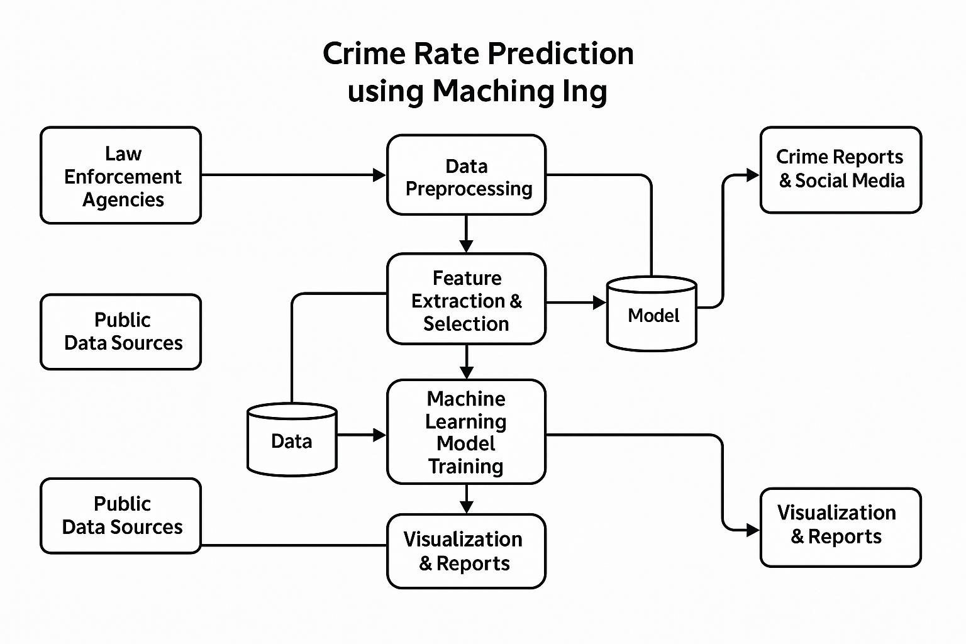
DATA FLOW DIAGRAM

Slide 12
DATA FLOW DIAGRAM
Level 0 (Context Diagram)
Entities: Law Enforcement, Public Data Sources, Users
Processes: Data Collection, Model Training, Prediction, Visualization
Data Stores: Crime Database, ML Model Repository, Prediction Results
Flow:
Agencies & sources provide crime data
Data is cleaned & stored
ML model is trained & predicts crime rates
Results are visualized for users
Level 1 (Detailed View)
Data Collection & Preprocessing → Cleaned crime data stored
Model Training → ML model trained & saved
Crime Prediction → Future crime rates predicted
Visualization & Reporting → Reports & insights generated

Slide 13
MAPPING
City Mapping
This data provides statistics on crimes committed in 19 metropolitan cities during the year 2014 to 2021. With the help of this application, we can predict the crime rates for 10 different categories of crime that are likely to occur in 19 Indian metropolitan cities over the next few years. Cities are:
Ahmedabad - 0
Bengaluru - 1
Chennai - 2
Coimbatore - 3
Delhi - 4
Ghaziabad - 5
Hyderabad - 6
Indore - 7
Jaipur - 8
Kanpur - 9
Kochi - 10
Kolkata - 11
Kozhikode - 12
Lucknow - 13
Mumbai - 14
Nagpur - 15
Patna - 16
Pune - 17
Surat - 18

Slide 14
MAPPING
Crime Mapping
It includes statistics on 10 different categories of crime, including murder, kidnapping, crime against women, crime against children, crime committed by juveniles, crime against senior citizens, crime against SC, crime against ST, economic offences and cybercrimes. Like as
Crime Committed by Juveniles - 0
Crime against SC - 1
Crime against ST - 2
Crime against Senior Citizen - 3
Crime against children - 4
Crime against women - 5
Cyber Crimes - 6
Economic Offences - 7
Kidnapping - 8
Murder - 9

Slide 15
METHODOLOGY
Data Acquisition: Collect data from publicly available crime databases, government reports, or third-party datasets (e.g., Kaggle, government crime portals).
Exploratory Data Analysis (EDA): Analyze crime trends, identify correlations with other features, and explore patterns.
Machine Learning: Models
Evaluation: Split the dataset into training and test sets to validate model performance. Use cross- validation to ensure the robustness of the model.
Visualization and Reporting:
Developing a user-friendly dashboard or web interface to display real-time predictions and trends.
Visualizing crime hotspots and predictions on an interactive map to aid decision-making.

Slide 16
MACHINE LEARNING
Supervised Learning Algorithms: Use regression models (e.g., Linear Regression, Decision Trees, Random Forests) to predict crime rates based on input variables.
Clustering and Classification Models: Identify regions with higher likelihood of crime through algorithms like K-means, KNN (K-Nearest Neighbors), and Support Vector Machines (SVM).
Deep Learning Models: Implement neural networks to predict complex crime trends with greater accuracy.

Slide 17
1. Support Vector Machine (SVM)
SVM is a supervised learning algorithm that finds the hyperplane that maximally separates classes in the feature space.
Use cases: Classification, regression, and outlier detection.
Decision Trees are supervised learning algorithms that use a tree-like model to classify data or make predictions.
Use cases: Classification, regression, and feature selection.
2. Decision Tree

Slide 18
3. Neural Network
Neural Networks are machine learning algorithms inspired by the structure and function of the human brain.
Use cases: Image recognition, natural language processing, speech recognition &more.
KNN is a supervised learning algorithm that predicts the target variable based on the similarity between new data points and existing data points.
Use cases: Classification, regression, and recommendation systems.
4. KNN

Slide 19
5.RANDOM FOREST
Random Forest is an ensemble learning technique that combines multiple decision trees to generate a more accurate Prediction. It is a versatile and powerful algorithm used in a wide variety of Applications. The algorithm can be illustrated as follows:
Begin with a dataset of observations and their associated labels.
Randomly select ‘k’ features from the dataset.
For each of the ‘k’ features, choose the best split point.
Create a tree using the chosen split points.
Repeat steps 2-4 for each of the ‘k’ features.
Combine the trees to form a forest.
Use the forest to make predictions on new data.
Calculate the accuracy of the predictions.

Slide 20
RESULTS & DISCUSSION
The Random Forest Regression model demonstrates the best accuracy in predicting test data among the five selected models. The model predicts the crime rate with an accuracy of 93.20% on the testing data.
The accuracy results obtained after testing are listed below:
Algorithm | Mean Absolute Error | Mean Squared Error | R2 Score
Support Vector Machine | 10.3204 | 371.7907 | 0.17886
K-Nearest Neighbor | 6.58181 | 140.8179 | 0.55349
Neural Networks MLPRegressor | 12.4248 | 307.5506 | 0.24823
Decision Tree Regressor | 2.89024 | 34.95932 | 0.88915
Random Forest Regressor | 2.49143 | 21.43956 | 0.93201

Slide 21
PYTHON LIBRARIES
Flask provides the core framework for building web applications.
Gunicorn serves the application efficiently in production.
Jinja2 helps render dynamic pages using templates.
Werkzeug handles request processing and routing.
itsdangerous ensures secure data transmission.
MarkupSafe prevents security vulnerabilities like XSS.
zipp may assist in compressing and managing files.
importlib-metadata helps fetch package information.

Slide 22
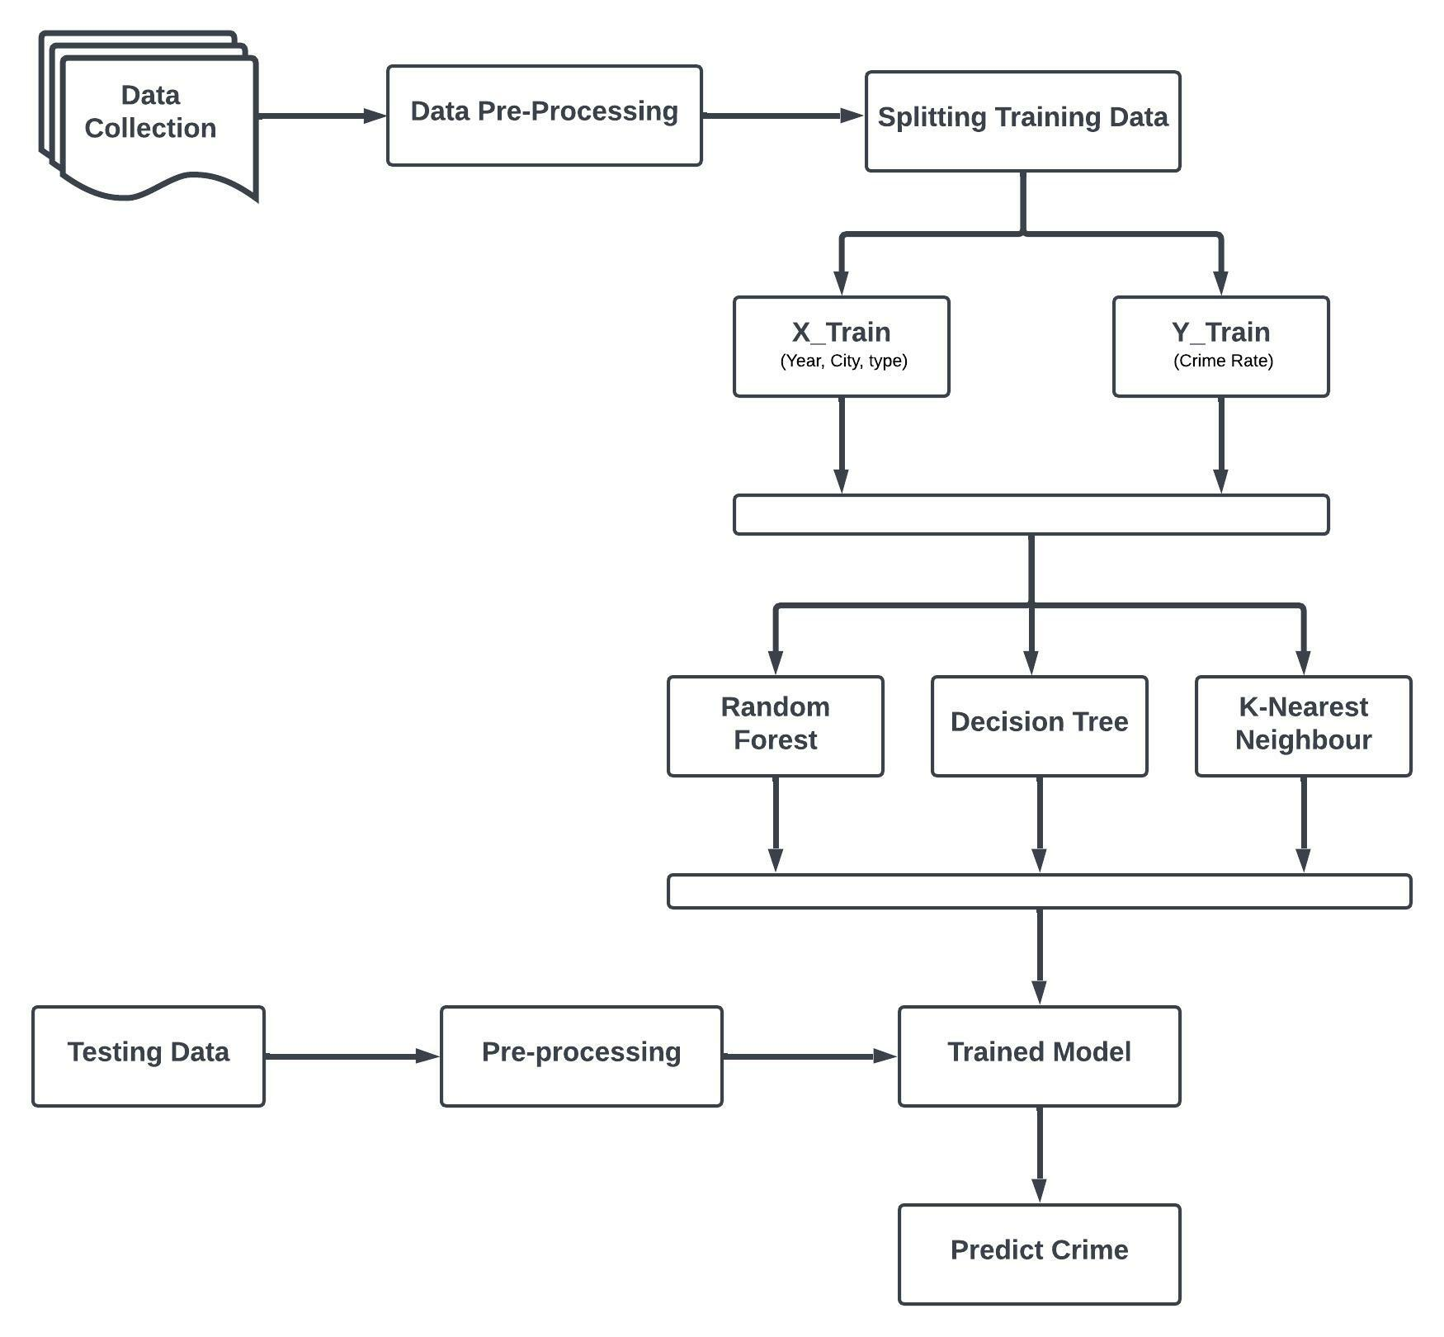
SYSTEM ARCHITECTURE

Slide 23
HARDWARE AND SOFTWARE REQUIREMENTS
Hardware Requirements
Hard disk | 10GB
RAM | 8 GB(Minimum)
Device | Laptop or PC
Software Requirements
Operating System | Windows 7/8/10/11
Languages Used | HTML, Python
Development Environment (IDE) | Conda, python 3.7
Software | Visual Studio Code

Slide 24
CONCLUSION
Crime rate prediction has become an important tool for law enforcement agencies to help them focus their resources in high-crime areas.
By focusing their resources in the right areas, police officers can help reduce the overall crime rate in a community.
As a result of machine learning technology, finding relationships and patterns between various data has become easier.
The model prediction of crime rate and data visualization helps in analysis of data set and prediction of crimes.
The model helped in understanding different crime datasets that can be used in implementing the factors that can help in keeping society safe.

Slide 25
FUTURE ENHANCEMENT
Crime rate prediction has become an important tool for law enforcement agencies to help them focus their resources in high-crime areas. With the help of sophisticated algorithms and data analysis, law enforcement agencies can predict when and where crimes are likely to occur.
By focusing their resources in the right areas, police officers can help reduce the overall crime rate in a community.
Predictive policing has already proven to be an effective tool in reducing crime rates in many areas, and it looks like it will continue to be a key tool in the future.

Slide 26
Thank You

